Slide 1

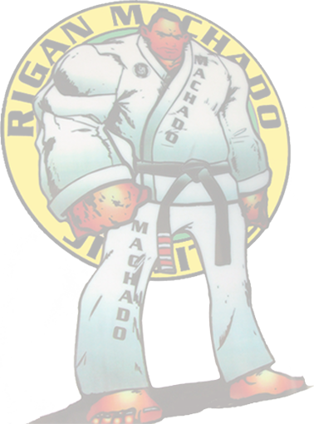



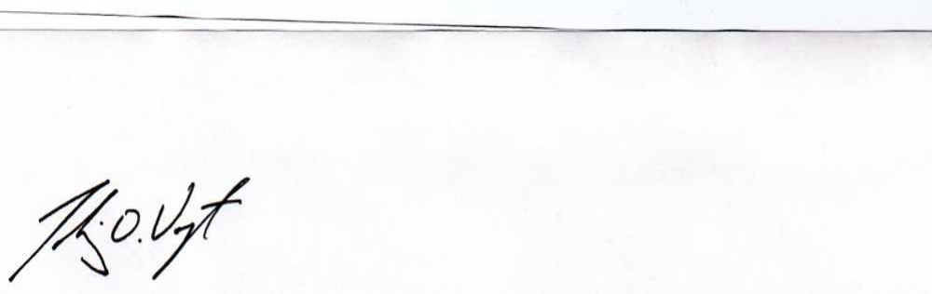
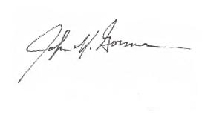
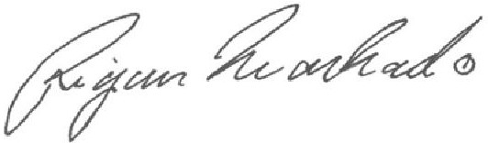
Certificate of Rank
柔術Lineage
Jigoro Kano
Mitsuyo Maeda
Carlos Gracie
Carlos Gracie, Jr.
Rigan Machado
Tobias Vogt
You
Black Belt
Tobias Vogt certifies the above named individual was promoted with honors and excellence on January 20, 2015, and is thereafter recognized at that rank in RCJ Machado Brazilian Jiu-Jitsu
Rigan Machado
Coral Belt 8th Degree
Dr. Tobias Vogt
Black Belt 5th Degree
John “PapaJohn” Gorman
Coral Belt 7th Degree

